Slide 1
minter
INFO 3604 Project
Supervisor: Inzamam Rahaman
Please Turn Up Your Volume

Slide 2
Agenda
Introduction:
Time Series Analysis (TSA)
Forecasting and Seasonality
TSA models implemented
Overview of Models:
Seasonal Autoregressive Integrated Moving Average (SARIMA)
Back-Propagation Neural Network (BPNN)
Long Short-Term Memory (LSTM)
Sample of Results
Work in Progress
References
Please Turn Up Your Volume

Slide 3

Introduction

Slide 4
Introduction
What is time series analysis
What is forecasting and seasonality
What models are being used

Slide 5
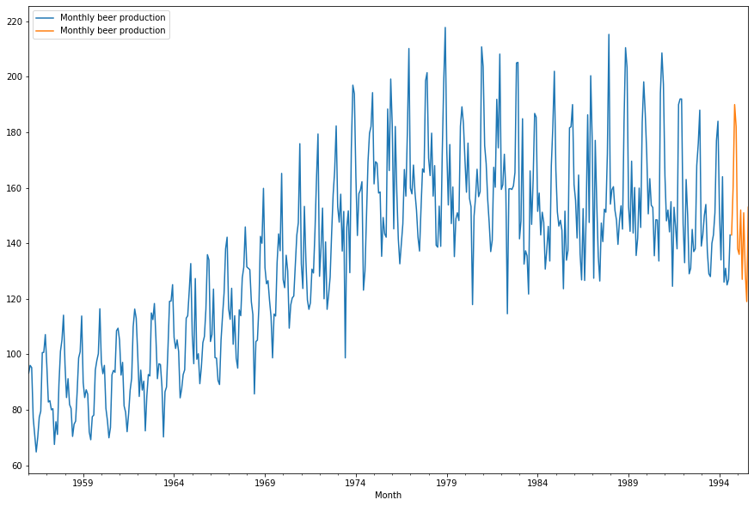
Seasonal Auto Regressive Integrated Moving Average

Slide 6
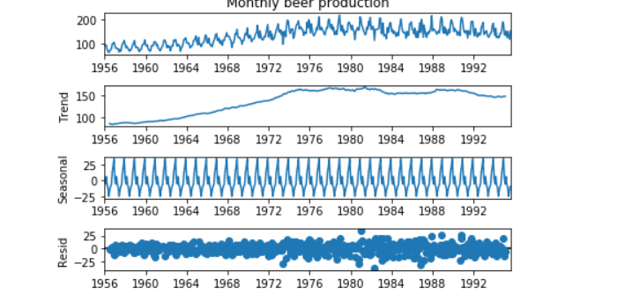
SARIMA Overview
Extension to the ARIMA(Auto Regressive Integrated Moving Average) model, in order to support seasonal data.
Autoregressive(AR) models forecast future events or behaviour based on past occurrences, in the case where there is correlation between values in a time series with the values the precede and succeed them.
SARIMA is still based on the premises of using dependencies of prior information to make predictions.
SARIMA adds four additional parameters, for the seasonal component of the series, that is:
-P: Seasonal autoregressive order
-D: Seasonal difference order
-Q: Seasonal moving average order
-m: The number of time steps for a single seasonal period
Notes:
SARIMA works by predicting results after building, fitting and training the model,
e.g train_data = df[:len(df)-12] test_data = df[len(df)-12:] ax = train_data.plot(figsize=(15,10)) test_data.plot(ax=ax,figsize=(15,10)).
2) Using errors previously talked about, we estimate the model’s accuracy(MSE, MAE,MAPE).
3) We arrive at results which give a prediction on future values.

Slide 7
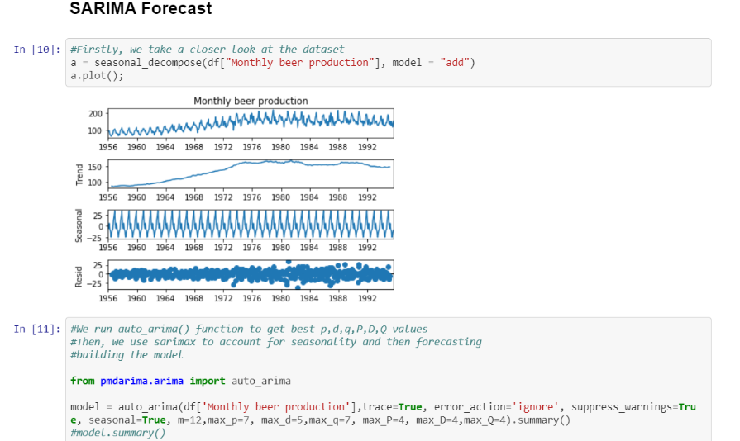
SARIMA Model Developed
SARIMA: how does it work?

Slide 8
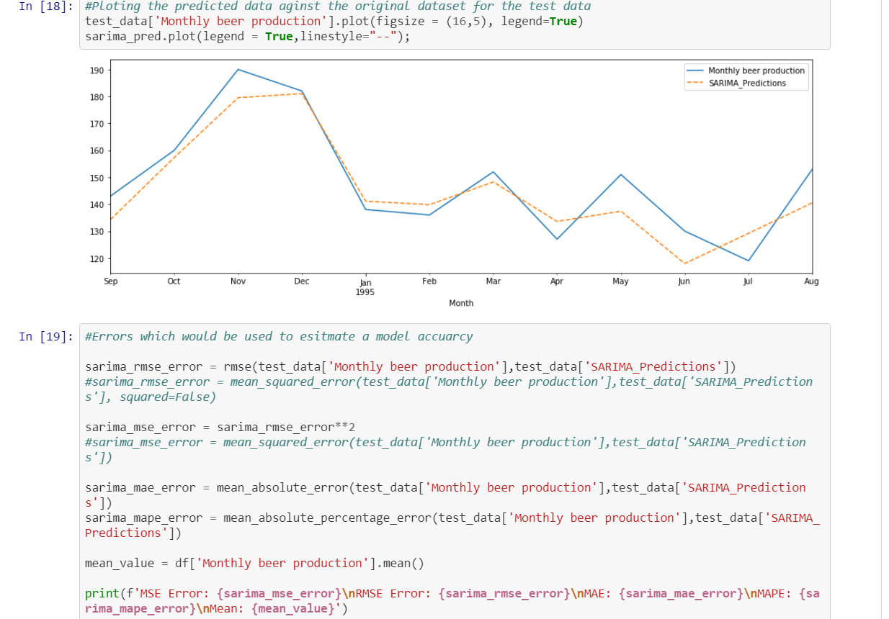
SARIMA Model Developed
SARIMA: how does it work? Continued

Slide 9
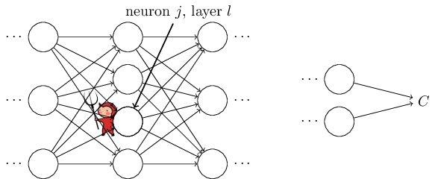
Backpropagation Neural Network

Slide 10
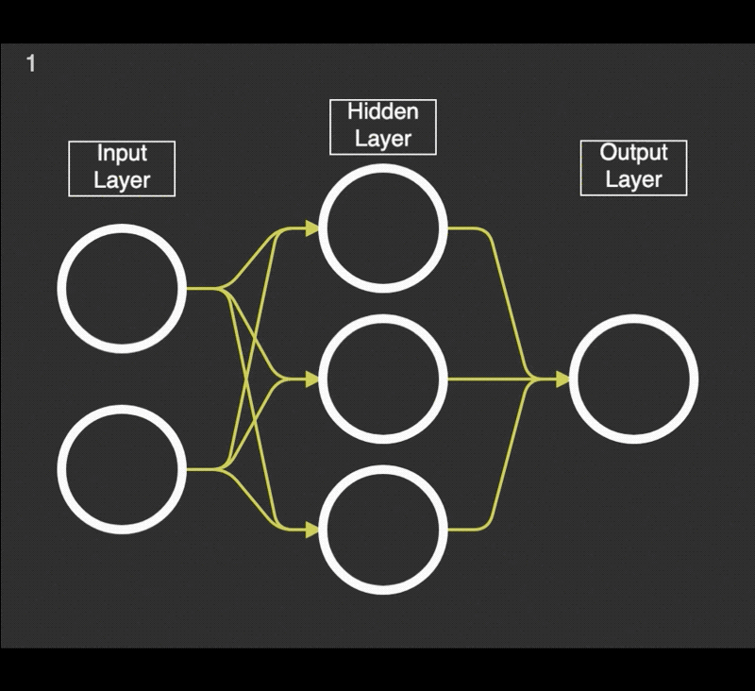
BPNN Overview
A neural network simply consists of neurons (also called nodes). These neurons are split between the input, hidden and output layer. These nodes are connected in some way.
The idea is that we input data into the input layer, which sends the numbers from our data ping-ponging forward, through the different connections, from one neuron to another in the network.
Backpropagation is the heart of every neural network. The algorithm is used to effectively train a neural network through a method called chain rule.
Figure 1. Neural Network
White circles corresponding to neurons, and yellow arrows are the connections (with a weight) from one neuron to another neuron.
Notes:
1.) These nodes are connected in some way. Then each neuron holds a number, and each connection holds a weight.
2.)In simple terms, after each forward pass through a network, backpropagation optimizes the cost function- called a backward pass while adjusting the weights and biases for each layer, so that we get the desired output in the output layer.
3)Therefore, backpropagation aims to minimize the cost function by adjusting network’s weights and biases. The level of adjustment is determined by the gradients of the cost function with respect to those parameters.

Slide 11
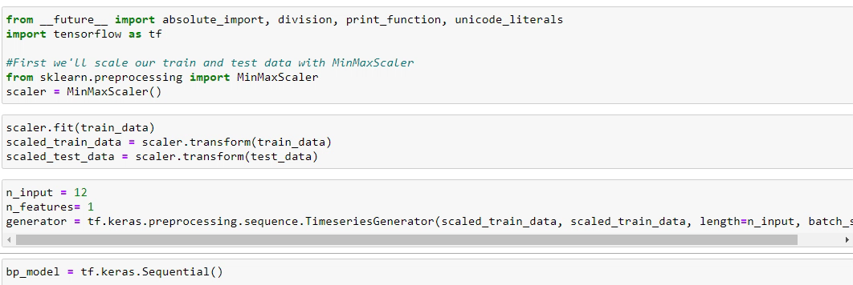
BPNN Model Developed
BPNN: how it works?
Notes:
1.) While the expression is somewhat complex, it also has a beauty to it, with each element having a natural, intuitive interpretation. And so backpropagation isn't just a fast algorithm for learning. It actually gives us detailed insights into how changing the weights and biases changes the overall behaviour of the network.

Slide 12
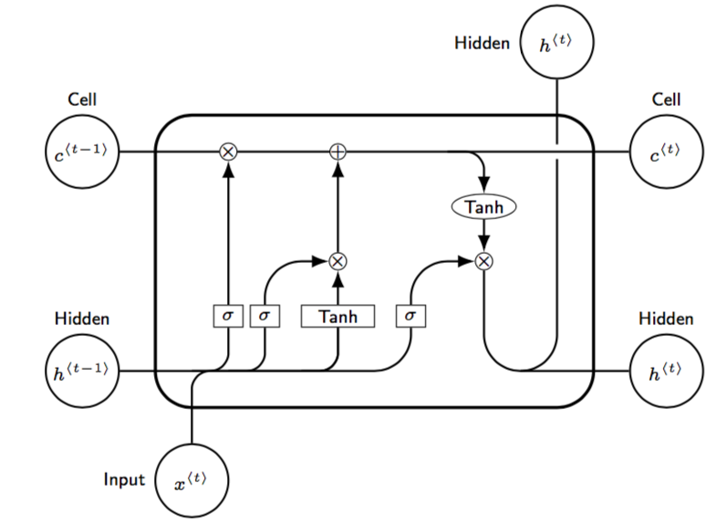
Long Short-Term Memory Network

Slide 13
LSTM Overview
Based off Recurrent Neural Networks. RNNs "remembers" the past and its decisions and is influenced by what it has learnt.
Long Short-Term Memory Networks are a special kind of RNN and is capable of learning long term dependencies.
In a "traditional" RNN inputs and the hidden state are passed through a single layer. LSTMs improve upon this by introducing additional gates and a cell state.
The cell state resembles a conveyor belt where some minor linear interactions may occur.
The gates "choose" whether the information is let through.
Figure 2.LSTM Network

Slide 14
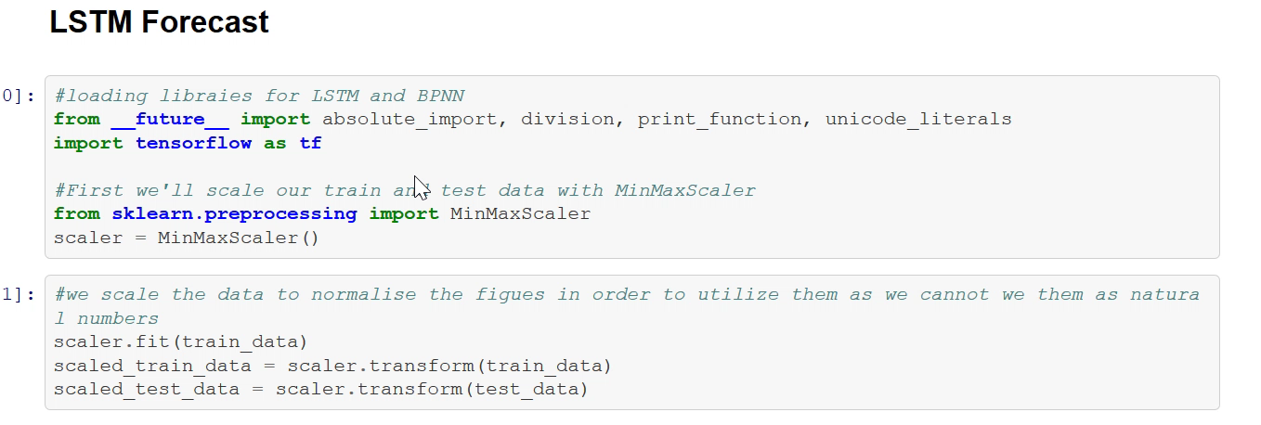
LSTM Model Developed
LSTM : how does it work?

Slide 15

Sample of Results

Slide 16
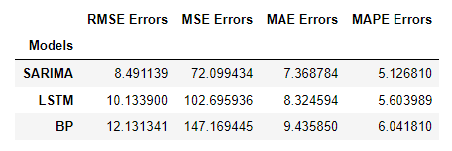
Sample of Results
Utilizing the monthly beer production in Oregon univariate dataset, we saw the following results were obtained
As shown by the error table, we can see that SARIMA outperformed the other models when forecasting seasonality in the dataset.
We are of the assumption that once completed, the neural ODE model would surpass all the models in predicting the seasonality trends in each dataset.
Table 1. Errors

Slide 17
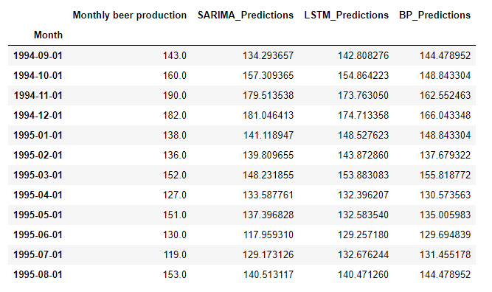
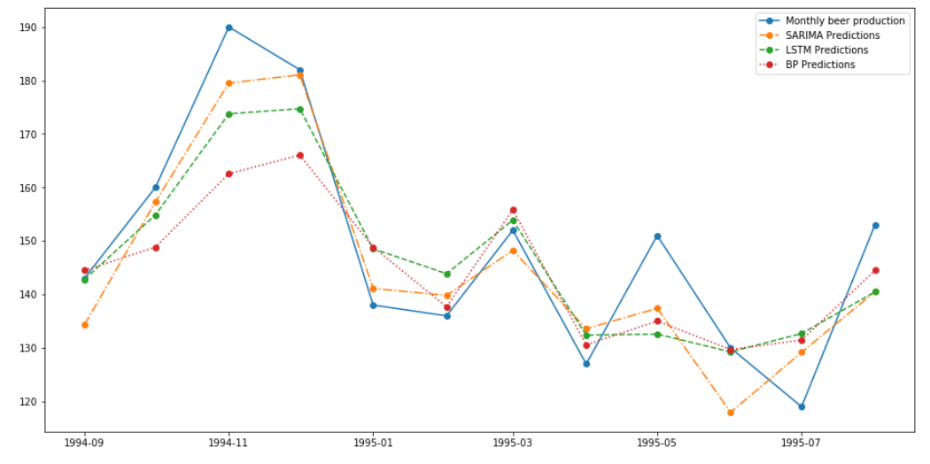
Sample of Results
Utilizing the monthly beer production in Oregon univariate dataset, we saw the following results were obtained
Table 2. Model Predictions
Figure x . Model Predictions Plotted

Slide 18
Work in Progress
We are currently working on fine tuning the Neural Ordinary Differential Equations (Neural ODEs) Model.
Started planning the paper.
We began sourcing or researching potential papers for the literature review

Slide 19
Thank you for viewing our presentation!!

Slide 20
References
Hansen, Casper. “Neural Networks: Feedforward and Backpropagation Explained & Optimization.“ ML from Scratch, August 5, 2019, https://mlfromscratch.com/neural-networks-explained/#/
Nielsen, Michael. Neural Networks and Deep Learning. Determination Press, 2015. http://neuralnetworksanddeeplearning.com/index.html

